Slide 1
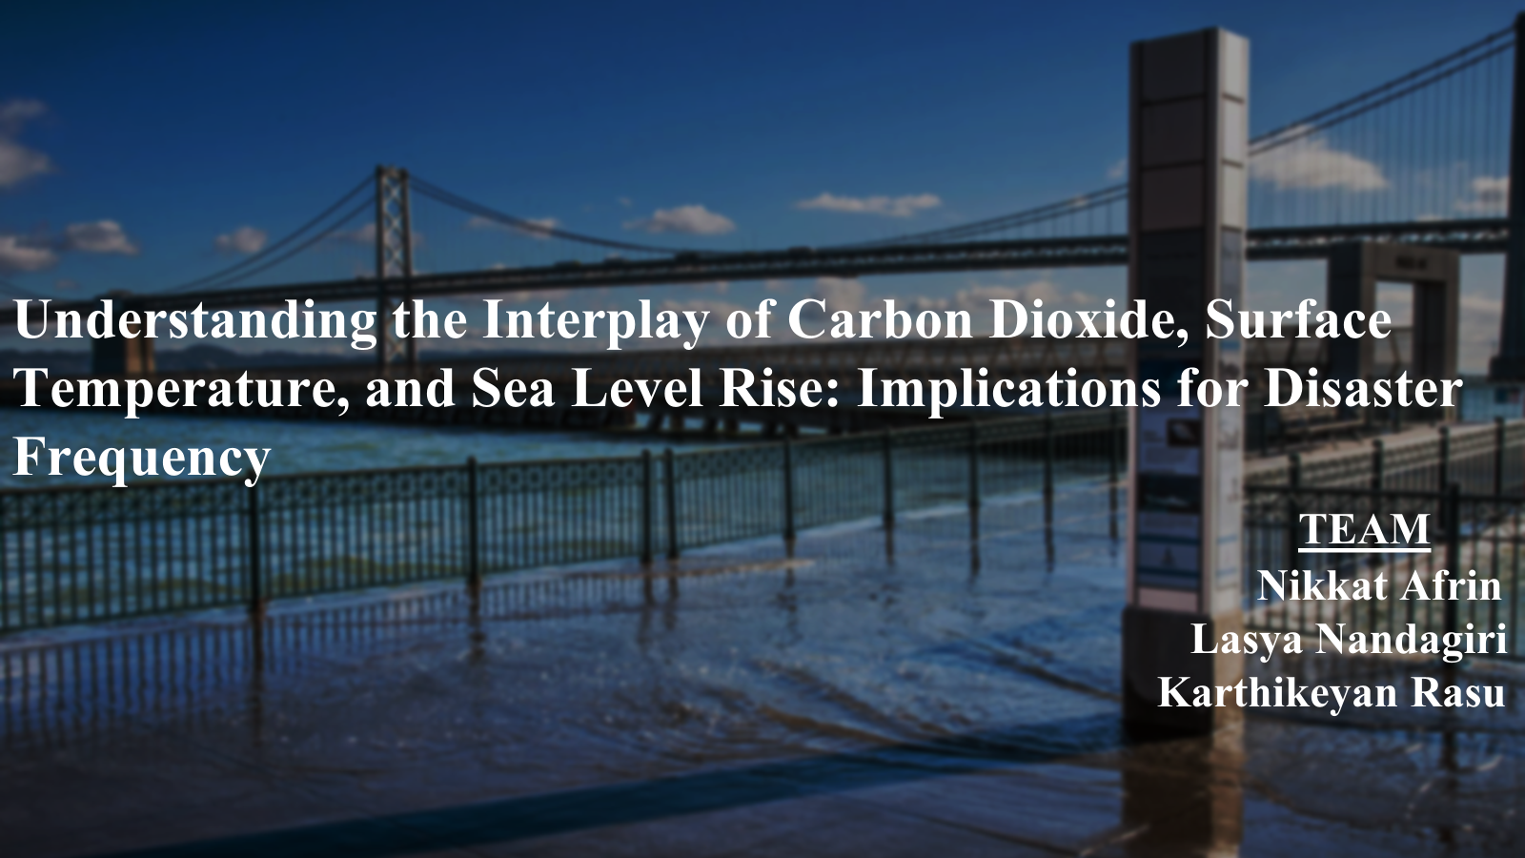

Slide 2
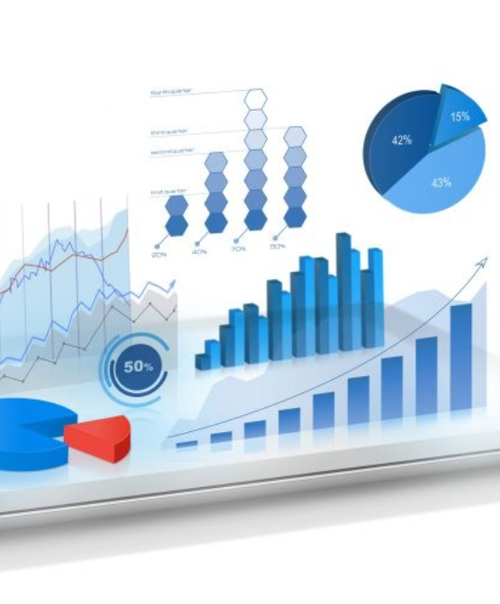
Agenda
Data Acquisition
Conclusion
Introduction
EDA and Analysis
Data Jargon
Feature Engineering
Research Analysis

Slide 3
INTRODUCTION
Over the past few decades, the world facing significant environmental changes mainly due to increasing levels of carbon dioxide. The rise in carbon dioxide levels shows its impact and resulting in global warming, rising oceans, natural calamities, and adverse effects on human health and the economy.
Our research aims to determine the correlation between past 30 years CO2 concentrations, surface temperature rise, sea level change, and natural disaster frequency to address environmental concerns.
For this project, We used data from various sections within the IMF's Climate Change Data site.

Slide 4
Data Acquisition
For our project we collected data from the IMF Climate change Dashboard.
We choose 4 different data set for carrying out our research of finding the correlation.
Data set 1: Annual Surface Temperature Change ( CSV)
Source Link: https://climatedata.imf.org/datasets/4063314923d74187be9596f10d034914/explore
Data Set 2: World Monthly Atmospheric Carbon Dioxide Concentrations (CSV)
Source Link: https://climatedata.imf.org/datasets/9c3764c0efcc4c71934ab3988f219e0e/explore
How? https://gml.noaa.gov/ccgg/about/co2_measurements.html
Data Set 3: Change in Mean Sea Levels (CSV)
Source Link: https: https://climatedata.imf.org/datasets/b84a7e25159b4c65ba62d3f82c605855/explore
Data Set 4: Climate-related Disasters Frequency ( Web API) (In JSON)
API : https://services9.arcgis.com/weJ1QsnbMYJlCHdG/arcgis/rest/services/Indicator_11_1_Physical_Risks_Climate_related_disasters_frequency/FeatureServer/0/query?outFields=*&where=1%3D1&f=geojson

Slide 5
Data Jargon
Baseline climatology : The term “baseline climatology” refers to a reference period used to calculate anomalies in climate data. In our data set the climate data from this period (1951-1980) is being used as a standard or reference point to understand how global temperatures have changed over time.
satellite radar altimeters: Satellite radar altimeters are instruments used in satellites to measure the height of the satellite above the Earth’s surface, specifically the ocean surface. the change in mean sea levels from 1992-12-17 to 2022-08-10 is estimated using measurements from these satellite radar altimeters. The data is presented with three-quarters of the data points for every month, and estimates are provided for 24 regions across the world, along with a global estimate.

Slide 6
Exploratory Data Analysis

Slide 7
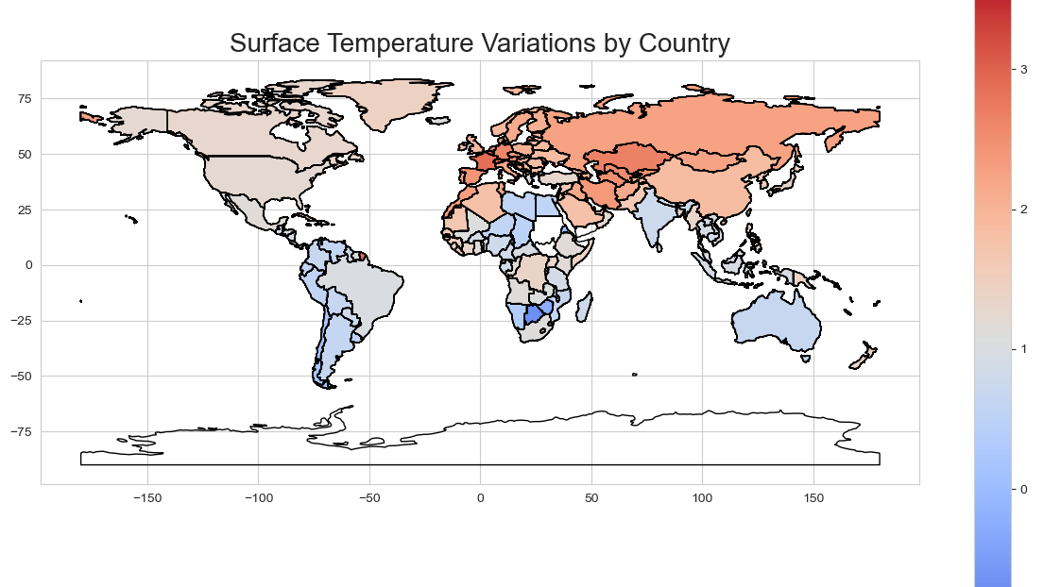
Data set 1 : Annual Surface Temperature Change EDA

Slide 8
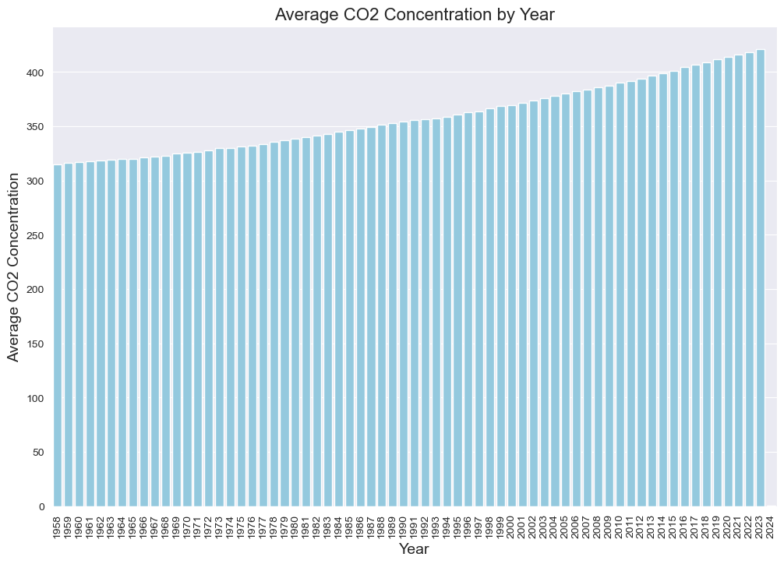
DATA SET 2: Atmospheric Carbon Dioxide Concentration
EDA

Slide 9
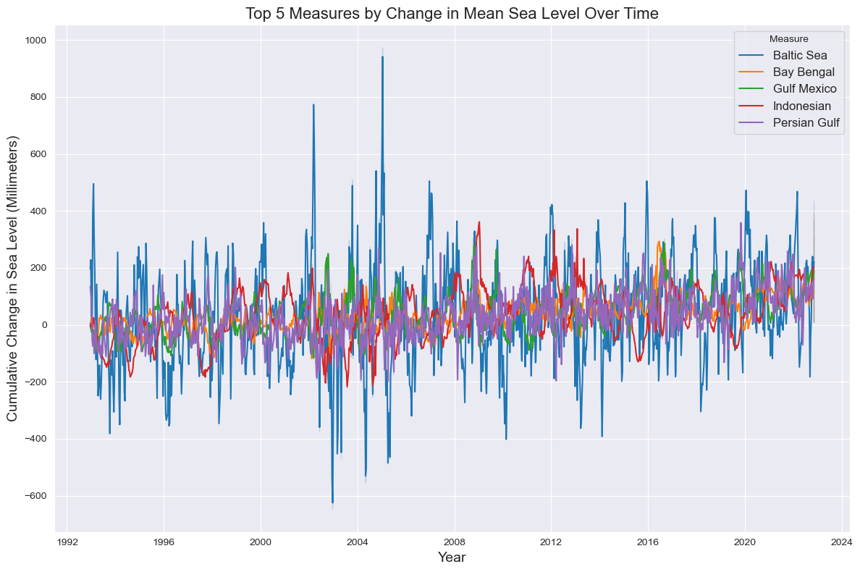
Data set 3 : Mean Sea Level Changes
EDA

Slide 10
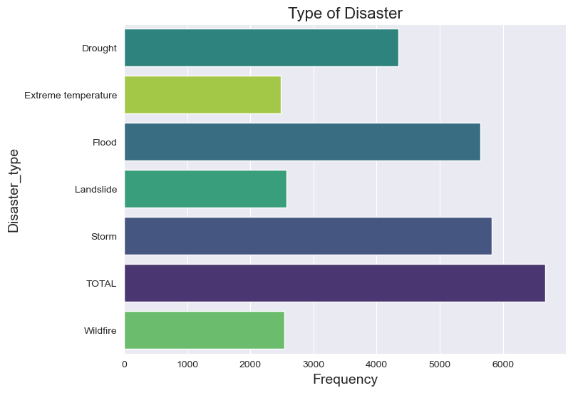
Data set 4 : Climate-related Disasters Frequency
EDA

Slide 11
Data Preparation and Feature engineering

Slide 12
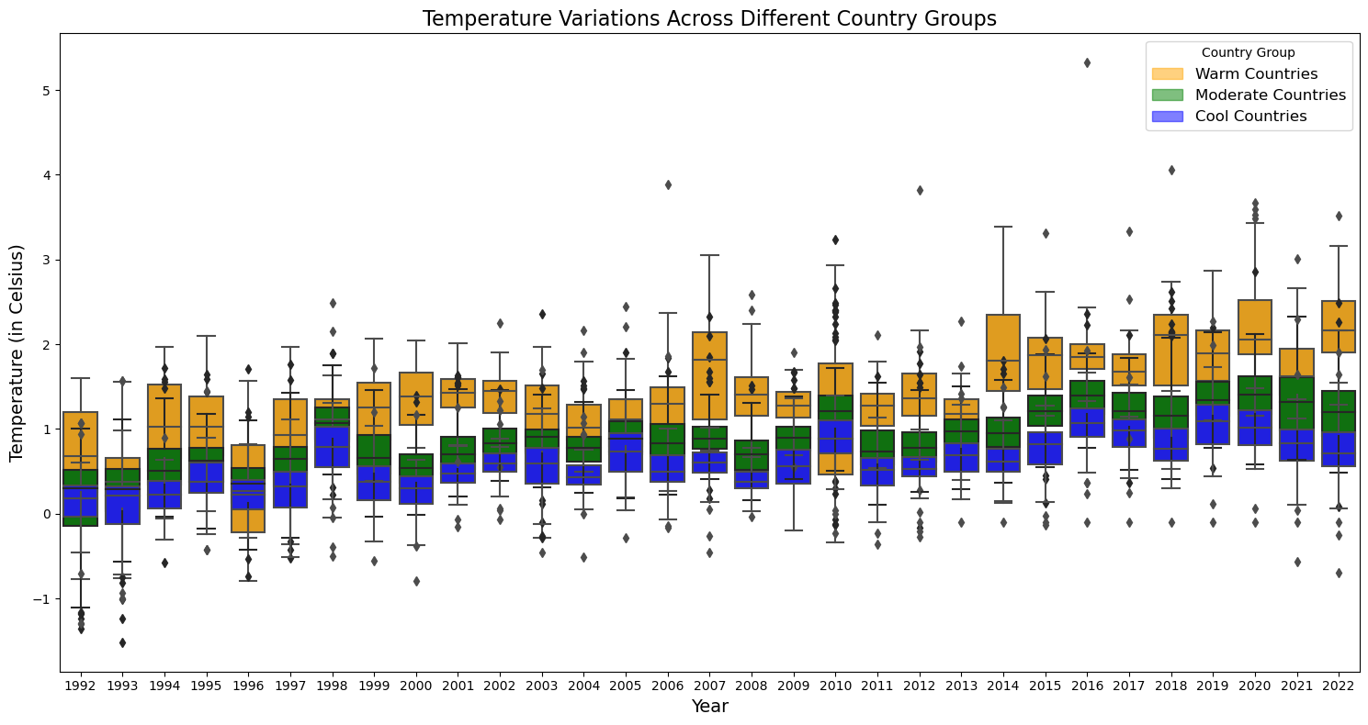

Slide 13
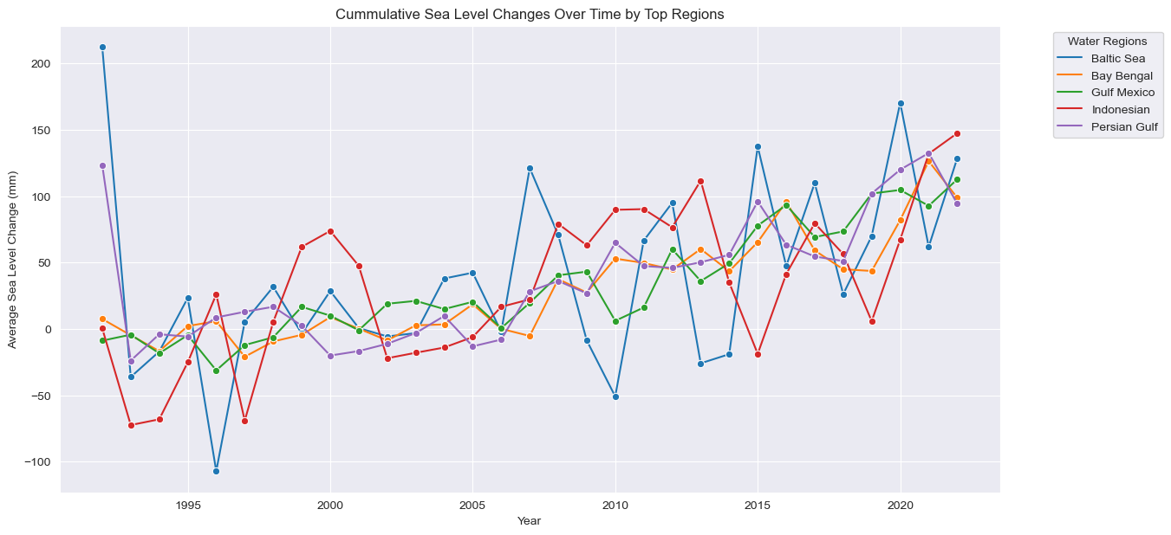

Slide 14
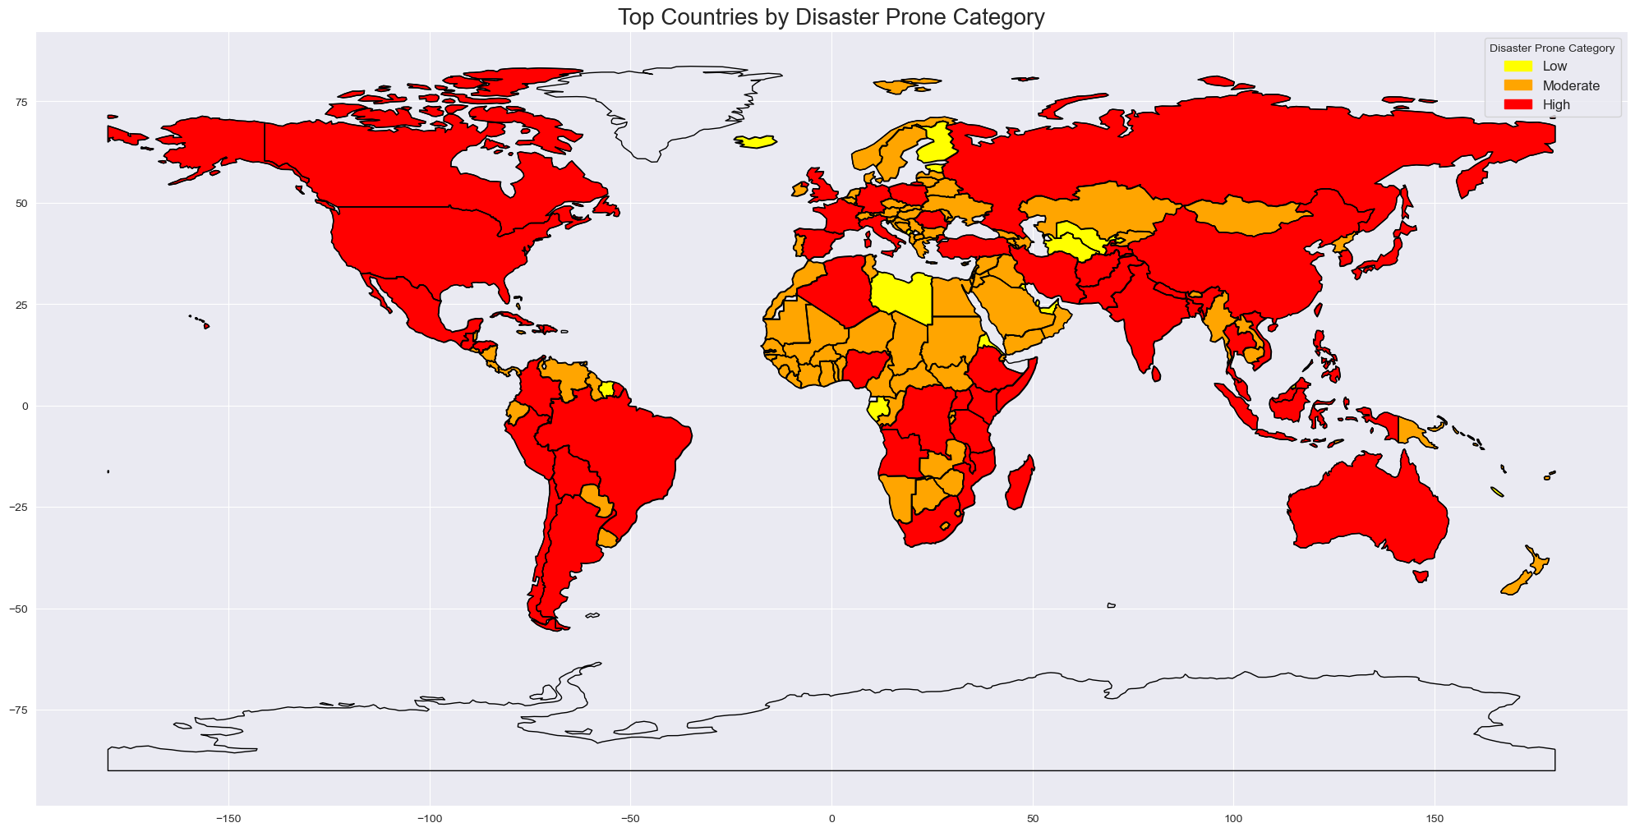

Slide 15
Research analysis

Slide 16
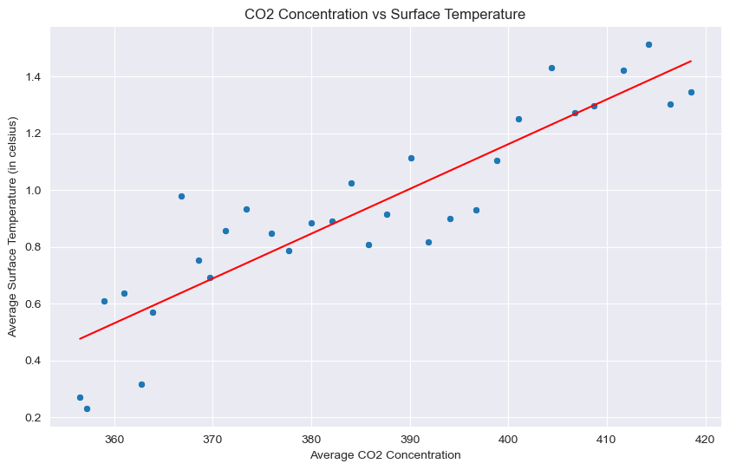

Slide 17
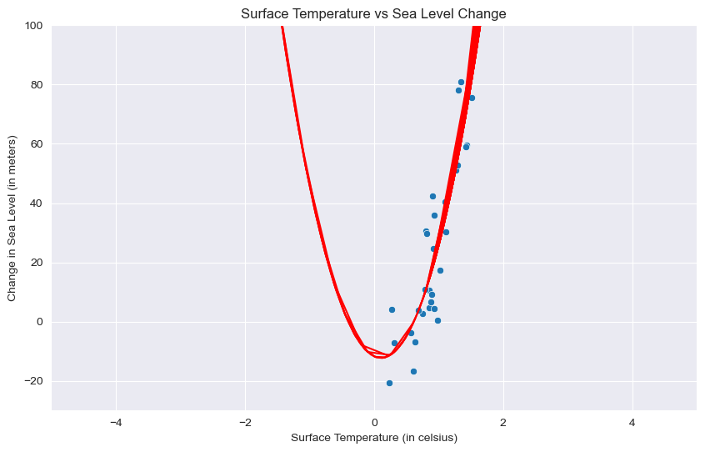

Slide 18
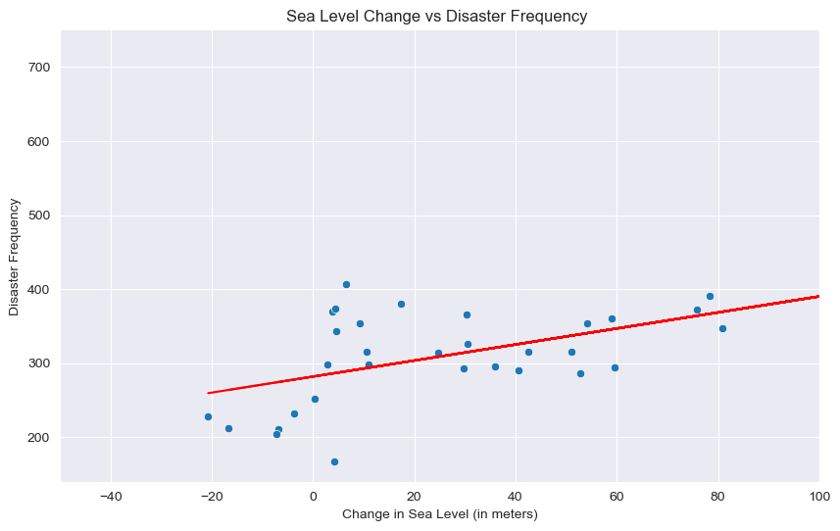

Slide 19
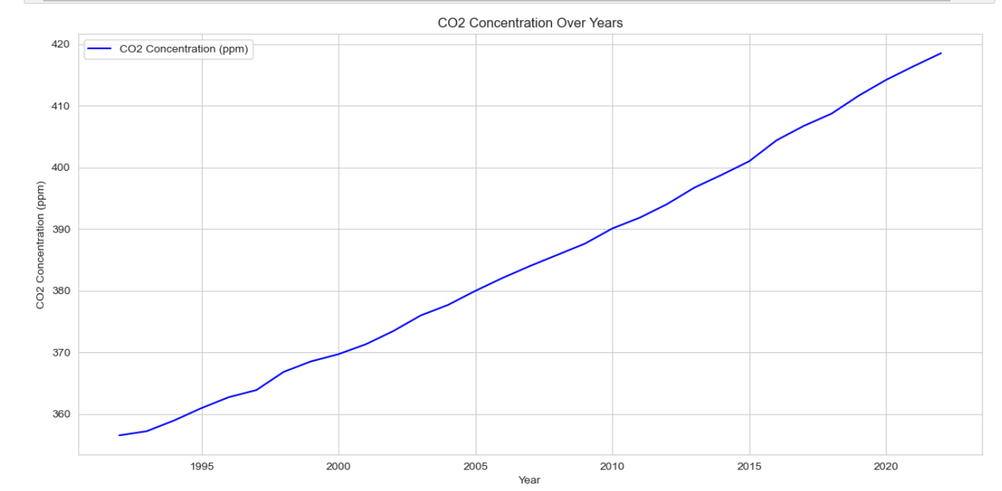
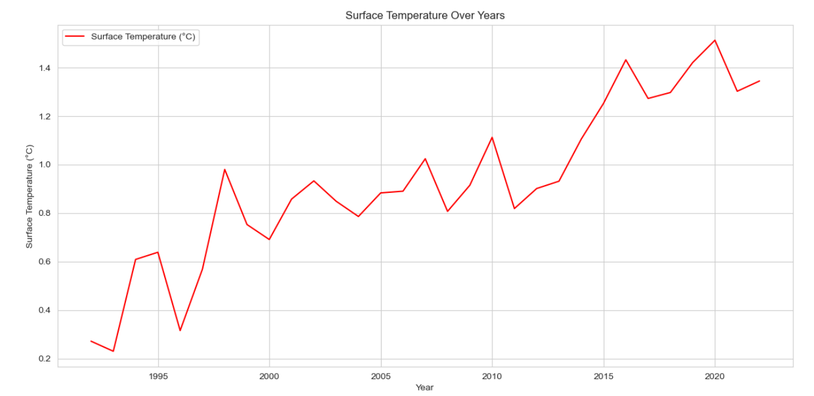
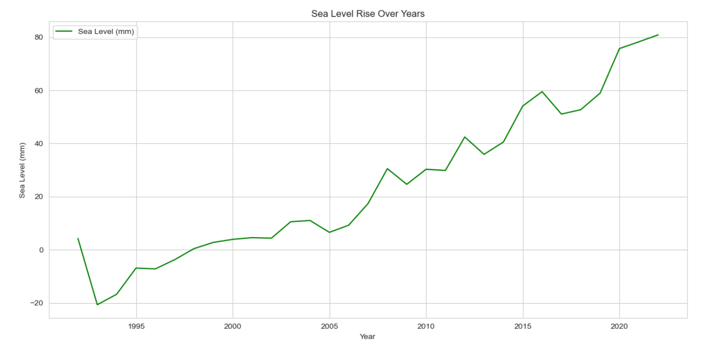
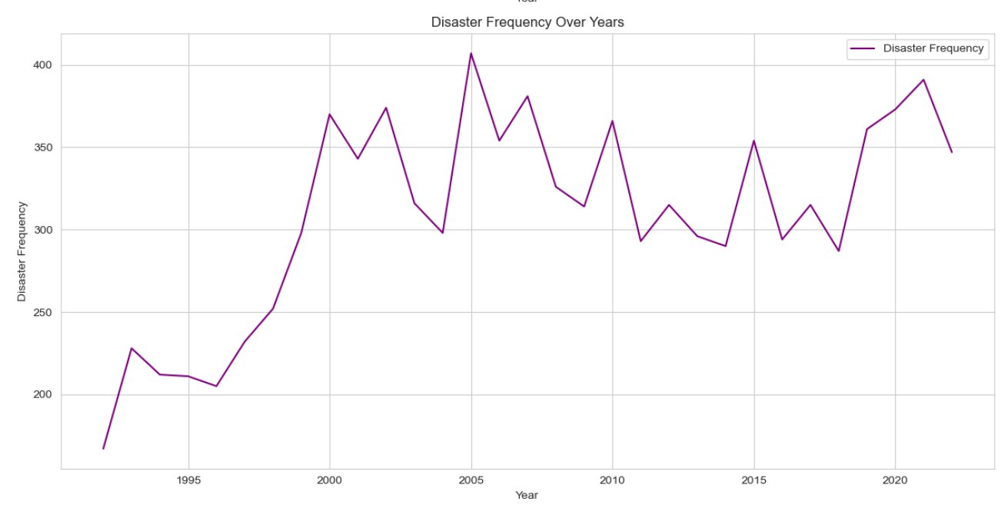
TREND ANALYSIS

Slide 20

Conclusion
All the correlations are pretty evident, CO2 concentration and surface temperature, surface temperature and Average Sea Level, and Average Sea Level and Disaster Frequency.
There is a non-linear relationship between average sea level and surface temperature.
In the last 30 years we saw the CO2 levels rise by 64.5ppm, while the 30 years before those 30 saw an increase of 38.09 only. We are seeing more than double rise in co2 in this last three decade.
The most common thing in the top 10 countries that are recording high disasters is that all of these countries are coastal countries.

Slide 21

Thank you

